Slide 1


SECURE SOFTWARE DEVELOPMENT (SSD)
Diploma in CSF
Academic Year (AY) 20/21 – Semester 3 (April `20)
Week 5
Secure software Design – Part 1
Last Updated: 02/04/2020

Slide 2
Contents
Benefits of Secure Design
Designing Confidentiality,, Integrity & Availability Techniques
Mission 5.1: Security Design Techniques (Optional)
Remote Learning Instructions
Mission 5.2: Razor Pages Security II

Slide 3
Remote Learning Instructions
Step 1
Read Secure Design Reading Materials
Read Benefits of Secure Design (slide 4)
Watch & Read Designing Confidentiality Techniques (Slides 5-8)
Watch & Read Designing Integrity Techniques (Slides 9-25)
Watch & Read Designing Availability Techniques (Slides 23-27)
Step 2
Do Mission 5.1 (Optional)
More details in slide 28
Step 3
Do Mission 5.2
More details in slide 29
Step 4
Do Reflections
More details in slide 30

Slide 4
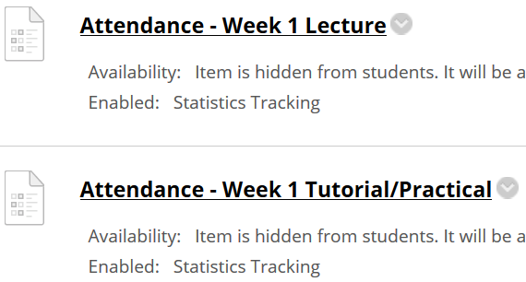
Important Details
VERY IMPORTANT
Visit MEL to start each week’s lesson. Learning materials will ONLY be released in MEL
Attendance Poll Attempt TWO attendance polls every week Starts Monday (9am) till Friday (11:59pm) Attendance :– Week x Lecture ( x refers to week number) Week x Tutorial/Practical Just click “Save and Submit”
Always lookout for announcements Do keep abreast of announcements in MEL
In light of the Covid-19 situation, your cooperation in adhering to the points mentioned is much needed and greatly appreciated.

Slide 5
Benefits of Secure Design
Minimizes the time needed to fix identified security issues
Assures stakeholders trust because the software is:
Reliable (functioning as expected and less prone to errors)
Resilient (less likely to be successfully exploited)
Recoverable (more prone to be able to restore itself to normal business operations upon error or exploitation)
Requires minimal redesign when the software is designed with future threats in mind
Designing software with security in mind, business logic flaws and other architectural design issues can be uncovered.

Slide 6
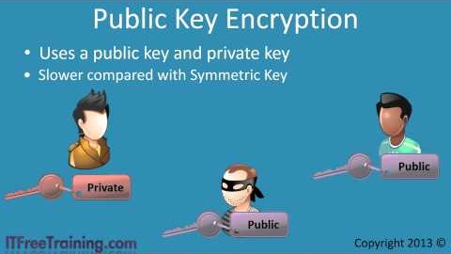
Designing Confidentiality Techniques
Encryption :-
Symmetric Key Cryptosystem (SKC)
Asymmetric Key Cryptosystem (ASKC)
Combining SKE & ASKE

Slide 7
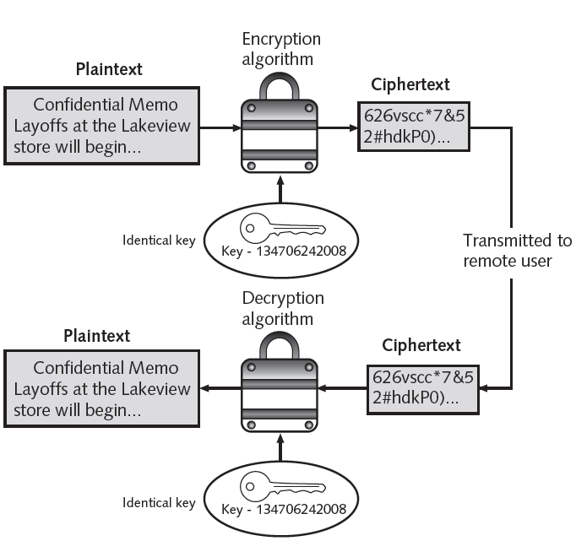
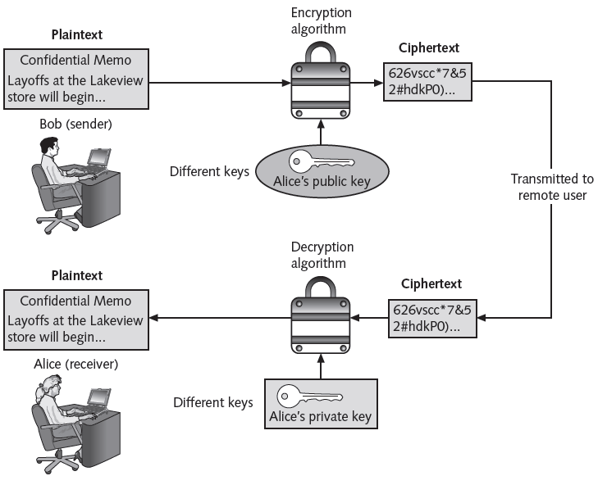
SKC or ASKC (Symmetric Key Crypto or Asymmetric Key Crypto)
Write the correct crypto algorithm (SKC or ASKC) for figures below.
Figure A - ___________
Figure B - ___________
Write answer in word document.
Figure A
Figure B

Slide 8
Symmetric (SKC) vs. Asymmetric (ASKC)
Uses a secret key to encrypt and to decrypt messages. | Uses two keys, one by the sender and one by the receiver to encrypt and to decrypt messages respectively. The two keys are mathematically related.
The secret key cannot be made public and known only to the sender and receiver. | One of the keys, i.e. the public key can be made known to all parties concerned. While the sender keeps the other key, i.e. private key.
Need a secure channel to distribute the key. | Allows public keys to be exchanged out in the open over insecure communication channels.
Perform faster than most public key cryptographic algorithms. | Perform slower than most symmetric cryptographic algorithms.
Number of symmetric keys = N(N-1)/2, where N is the number of users in the group | Number of Asymmetric Keys = 2N, where N is the number of users in the group
Satisfies only Confidentiality, Availability | Satisfies Confidentiality, Availability, Authentication, Non-Repudiation

Slide 9




Combine SKE & ASKE
Read SSL Cryptography
Cipher Text 1
Large Msg.
Encr. Algo.
Decr. Algo.
LargeMsg.
Sender
Cipher Text 2
Receiver
Encr. Algo.
Decr. Algo.
Symmetric Key
Symmetric Key
Receiver’s Public Key
Receiver’s Private Key
2. With respect to diagram above, what does Cipher Text 2 refer to? And what does Cipher Text 1 refer to? Write your answer in word document.

Slide 10
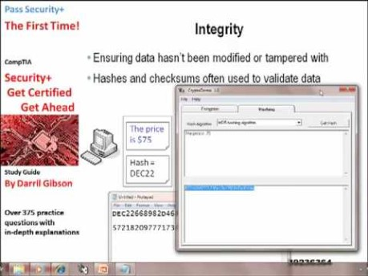
Designing Integrity Techniques
Integrity Techniques
Hashing
Digital Signature
Code Signing
Referential Integrity
Resource Locking

Slide 11
Data Integrity using Hash Functions
Graphical representation of data integrity using hash function from the video in Slide 9.
Figure C
Source: Official (ISC)² CSSLP CBK – 2nd Edition - Mano Paul

Slide 12
Unsalted vs Salted Hash
Unsalted Hash
Salted Hash
Figure D
3. Refer to Figure D above. Research and explain the purpose of salted hash? Write your answer in word document.

Slide 13
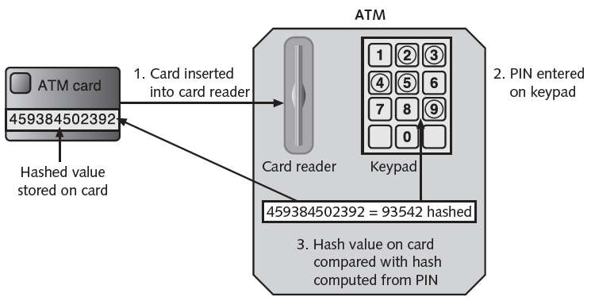
Example of Hash Function
Example of hashing (ATMs)
Bank customer has PIN of 93542
Number is hashed and result stored on card’s magnetic stripe
User inserts card in ATM and enters PIN
ATM hashes the pin using the same algorithm that was used to store PIN on the card
If two values match, user may access ATM
(Source: SECURITY+ GUIDE TO NETWORK SECURITY FUNDAMENTALS - 4th Edition – Mark Ciampa - Cengage Learning )

Slide 14
Characteristics of Cryptographic Hash Functions
Secure hashing algorithm characteristics
Fixed size
Short and long data sets have the same size hash
Unique
Two different data sets cannot produce the same hash
Original
Dataset cannot be created to have a predefined hash
Secure
Resulting hash cannot be reversed to determine original plaintext
(Source: SECURITY+ GUIDE TO NETWORK SECURITY FUNDAMENTALS - 4th Edition – Mark Ciampa - Cengage Learning )

Slide 15
Popular Hash Functions
Message Digest 5
Weaknesses in compression function could lead to collisions
Secure Hash Algorithm (SHA)
More secure than MD
No weaknesses identified
SHA-1, SHA-2, SHA-3
SHA-1 to be phased out gradually by 2017
SHA-2
The SHA-2 family consists of six hash functions with digests (hash values) that are 224, 256, 384 or 512 bits
(Source: SECURITY+ GUIDE TO NETWORK SECURITY FUNDAMENTALS - 4th Edition – Mark Ciampa - Cengage Learning )

Slide 16
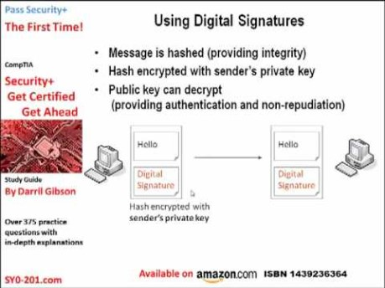
Digital Signature
Verifies the sender
Authentication
Prevents sender from disowning the message
Non-Repudiation
Proves message integrity
Integrity

Slide 17
How to digitally sign a message?
Graphical representation of digital signature from the video in Slide 15.
Msg.
Hash Algorithm
Msg. Digest
Encryption Algorithm
Digital Signature
Sender
Step 1
Sender’s Private Key
Step 2
Attach Digital Signature to the Message
Digitally Signed Message
Msg.
Msg.
Digital Signature
Digital Signature
Receiver
Sender

Slide 18
How to verify a digitally signed message?
Graphical representation of digital signature from the video in Slide 15.
Digitally Signed Message from Sender
Separate Message & Digital Signature
Msg.
Msg.
Msg. Digest 1
Hash Algorithm
Receiver
Digital Signature
Digital Signature
Do digests 1&2 match?
then Message is Verified
If not: Message Unverified
Decryption Algorithm
Msg. Digest 2
Sender’s Public Key

Slide 19
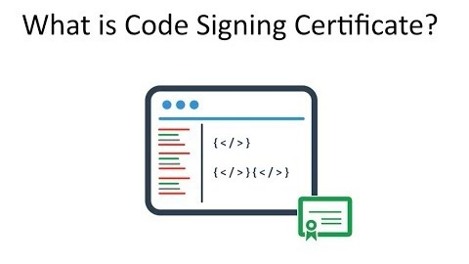
Code Signing
What Code Signing is and its purposes?
Code Signing is a process/mechanism/method that the software publishers use to publish code over the Internet.
Purpose of Code Signing is to ensure the user that the code is from the authentic publisher and also to ensure the user the integrity of the code after the code was published.

Slide 20
Code Signing
Two advantages of code signing:-
Authentication. Verifying who the author of the software is.
Integrity. Verifying that the software hasn’t been tampered with since it was signed.
Code signing provides the ability to trust updates. If you release an update to a software application and sign it uses the same key as the original application, the update can be automatically trusted because it couldn’t have come from anywhere other than you.

Slide 21
Code Signing
For example, say you write an application called WordWrite, sign it using your code signing certificate, and distribute it on your website. Before running the application, your users will see that it is signed by you and they will know that it hasn’t been changed by a hacker in the process of downloading it.
All major operating systems (Microsoft Windows, Apple OS X, Linux, etc.) and web browsers support code signing. They also use code signing to ensure that malicious code cannot be distributed through the patch system.
https://www.sslshopper.com/what-is-code-signing.html
Code Signing Tool – HashTab http://implbits.com/products/hashtab/

Slide 22
Referential Integrity
Integrity assurance of the data, especially in a relational database management system (RDBMS), is made possible by referential integrity, which ensures that data is not left in an orphaned state.
Referential integrity protection uses primary keys and related foreign keys in the database to assure data integrity.
Example: If customer orders are tied to a customer and the customer is deleted/updated from the database, the order records must be deleted/updated as well (cascading deletes/updates) . Failure to have referential integrity would lead to order (child) records existing in the database without being tied to a customer (parent)

Slide 23
Resource Locking
Resource locking can be used to assure data or information integrity.
When two concurrent operations are not allowed on the same object (say a record in the database), because one of the operations locks that record from allowing any changes to it, until it completes its operation, it is referred to as resource locking.
If resource locking protection is not properly designed, it can lead to potential deadlocks and subsequent denial of service (DoS).
Deadlock is a condition when two operations are racing against each other to change the state of a shared object and each is waiting for the other to release the shared object that is locked.

Slide 24

Designing Availability Techniques
Availability Techniques
Failover
Replication
Scalability

Slide 25
Failover
In computing, failover refers to the automatic switching from an active transactional software, server, system, hardware component or network to a standby (or redundant) system.
In order to assure high availability using failover techniques, it is imperative that all potential single points of failure are addressed in the design of the software solution.
Organizations might decide to eliminate the potential single point of failure presented by the single database server in the data tier. We could do this by adding a server to the data tier and creating a failover cluster from the existing database server, the new server, and a shared storage device.

Slide 26
Replication
A single point of failure is characterized by having no redundancy capabilities and this can undesirably affect end-users when a failure occurs.
By replicating data, databases and software across multiple computer systems, a degree of redundancy is made possible.
Replication usually follows a master-slave or primary-secondary backup scheme in which there is one master or primary node and updates are propagated to the slaves or secondary node either actively or passively.
Active/Active replication implies that updates are made to both the master and slave systems at the same time.
In the case of Active/Passive replication, the updates are made to the master node first and then the replicas are pushed the changes subsequently.
When replication of data is concerned, special considerations need to be given to address the integrity of data as well, especially in active/passive replication schemes.

Slide 27
Scalability
In computing, scalability is the ability of the system or software to handle increasing (or growing) amount of work without degradation in its functionality or performance.
The two primary methods of designing for scalability are:
Vertical scaling (also known as Scaling Up)
Horizontal scaling (also known as Scaling Out).
Vertical scaling means that additional resources are added to the existing node.
An example of scaling up is adding additional memory and storage to the existing application server or increasing the connection pool settings to handle greater connections to the backend database.

Slide 28
Scalability
Horizontal scaling means that newer nodes are added to the existing node.
An example of scaling out would be installing additional copies of the same software or adding a proxy cache server to the existing deployment of application and web servers from one to two or more.

Slide 29
Open-Ended Question
Qn 1: Of all the security design techniques that one can implement, designing against denial of service (DOS) attack is the most difficult/challenging. Do you agree? Explain.
Attempt the open-ended question above.
Submit your answers in Teams group.
SSD-AY2021-xxx-Pxx → Week 5
Use “Conversations” tab under “SSD-AY1920-xxx-Pxx → Week 5” to discuss within your class group.

Slide 30
Mission 5.1: Security Design Techniques (Optional)
Attempt the questions asked in slides 7, 9 and 12.
Discuss your answers with your group members.
Submit answer into Teams group
SSD-AY1920-xxx-Pxx-Txx → Week 5
Please note that this is an optional Mission.
If you got any issues or suggestions regarding Mission 5.1
Use “Conversations” tab under “SSD-AY1920-xxx-Pxx → Week 5” to discuss within your class group.
Tutors would also monitor these “Conversations”.

Slide 31
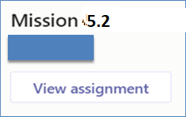
Mission 5.2: Razor Pages Security II (Individual)
Attempt the Razor Pages Security II practical
Click on “Files” tab and download the “Razor Pages Security 2 - Role based Authorization.docx”
Submit detailed screenshots of your completed practical page in MEL (General →Assignment (Mission 5.2 Razor Pages Security II)).
The screenshots must show the browser’s “Address Bar” to verify the application is running in your laptop.
Deadline: End of Week 5
Penalty for late submission
If you got any issues or suggestions regarding Mission 5.2
Use “Conversations” tab under “SSD-AY1920-xxx-Pxx → Week 5” to discuss within your class group.
Tutors would also monitor these “Conversations”.

Slide 32
Reflections - Individual
Reflect on Week 3, Week 4 and Week 5 lessons
Inside your “SSD-AY1920-xxx-Pxx-Txx → Week 5”
Create another Wiki/OneNote tab “Your Name - Reflection”, and answer the following questions.
Identify 3 important learning points acquired from Week 3, 4 & 5 lessons.
What do these learning points imply? Or what conclusions could you draw?
What will you do more of, less of, start or stop the next time? (In the context of the learning acquired thus far)
Deadline: Before the next week’s lesson

